Slide 1

Data Science Salaries from 2022-2023
Joshlyn Jamerson
Notes:
I chose the project, mainly because I’m nosey. I love learning about how much people make and what factors go into that. I decided to choose this dataset since everyone here has the potential for a future in the data science field.

Slide 2
Stakeholder Interest
Fair compensation
Negotiating power
Career planning
Transparency and equity
Notes:
Understanding the threshold for fair compensation is super important. It allows employers to know what is a fair wage to offer to people. This information can ensure they are being fairly compensated for their skills, experience, and contributions.
Wage information also allows those in search of a job to know what to expect.
This data can help individuals make informed decisions about career paths, job changes, and skill development to maximize their earning potential.
Access to salary information promotes transparency within organizations and across industries.

Slide 3
Data Cleaning
Duplicate data
Time formatting consistency
Converting time to integers
Date/time formatting
Removing outliers
Visual clarity on category ids

Slide 4
Agenda
Highest Paid Job Titles
How does experience level relate to pay
How does employee location relate to pay
Remote work
Ratio to on company size
Ratio compared to company location

Slide 5
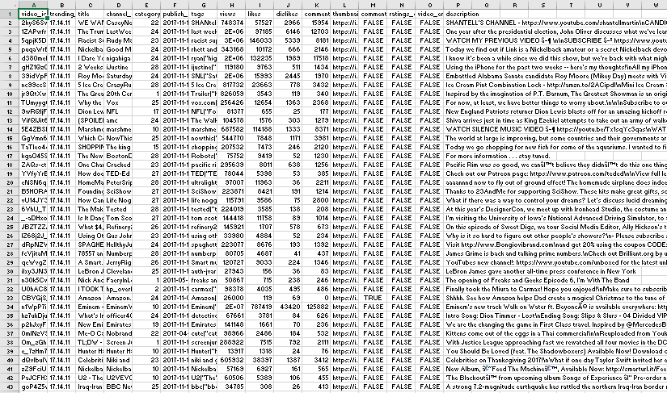
Data of Interest
Channel name
Trending date
Publish time
Views
Comment count
Video Id

Slide 6
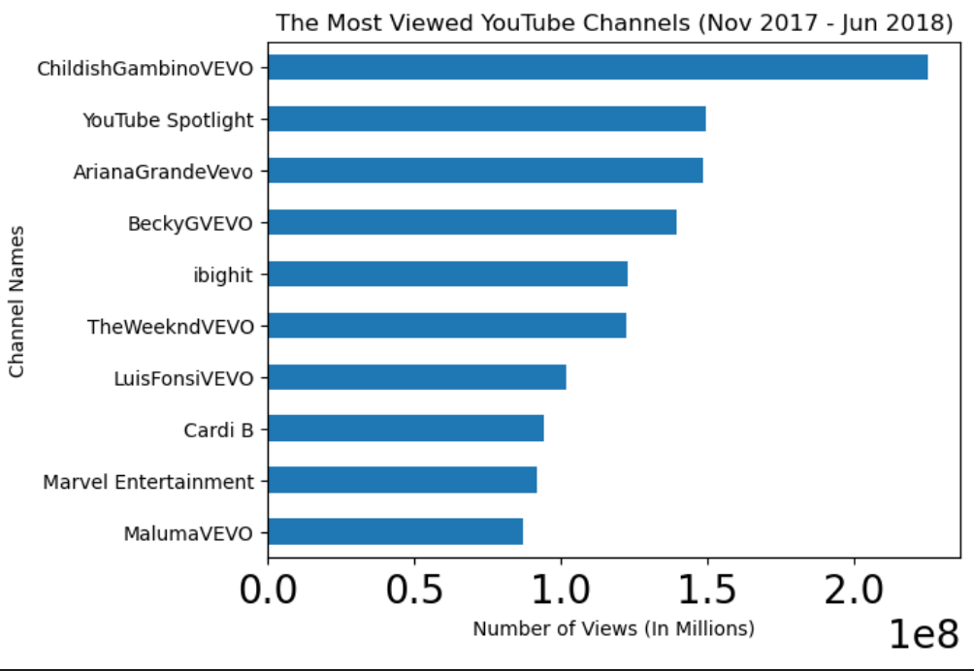
Notes:
Our analysis determined the top ten most viewed YouTube channels which can be used to target an advertising campaign.

Slide 7
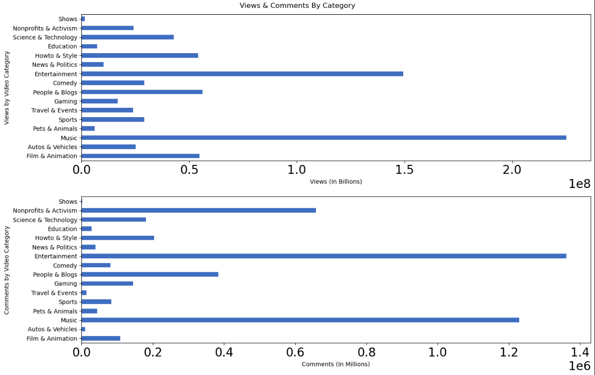
Notes:
Our analysis of the data can inform building advertising campaigns. We can demonstrate that to get the most visibility campaigns should seek to attach ads to ‘entertainment’ and ‘music’ videos due to their receiving 10x as many views as categories like ‘news & politics’ and ‘travel & events.’ Of note, while music videos receive the most views, viewers are most engaged with entertainment videos.

Slide 8
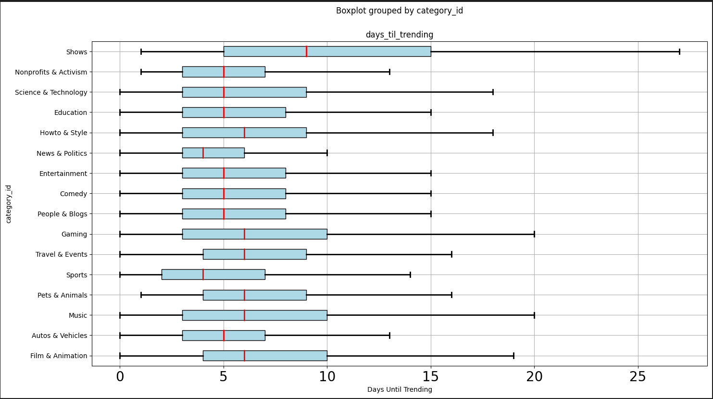
Notes:
Days til Trending shows that most categories of videos reach trending threshold with an average of five days from publication. This data can help inform the duration of an ad campaign.

Slide 9
Future Project Plans
Trending tags, identifying what makes a video trend
Duration of trending content
Identifying social media platforms in descriptions

Slide 10
Q&A
Teammates contact info
Link to repository
Link to dataset

